Slide 1
Multiplication Rule for Exponents
Integrated Mathematics

Slide 2
Objective
Students will apply the multiplication rules of exponents to
calculate the product of two or three mathematical terms.
Students will apply the negative and zero exponent rules to
calculate the product of two or three mathematical terms.

Slide 3
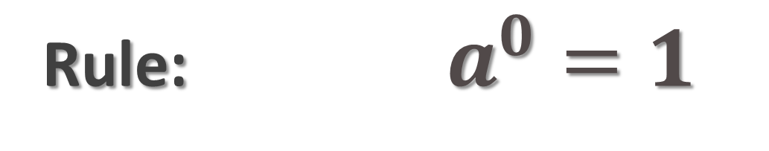
Zero Exponent Rule
Rule:$a^{0}=1$

Slide 4
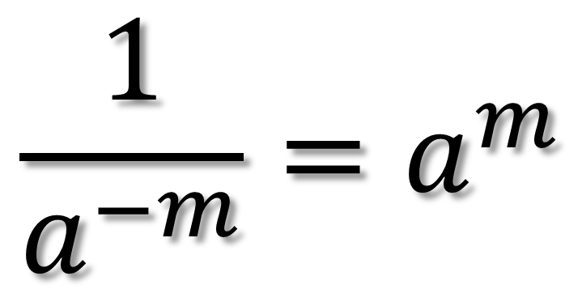
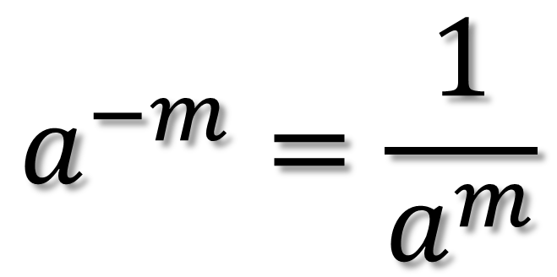
Negative Exponents
$$a^{−m}=\frac{1}{a^{m}}$$
$$\frac{1}{a^{−m}}=a^{m}$$
Rule:
* NEVER leave negative exponents in your answers!!

Slide 5
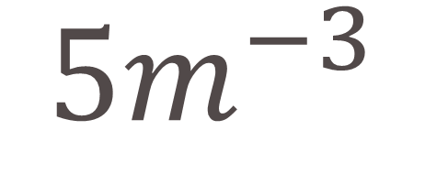
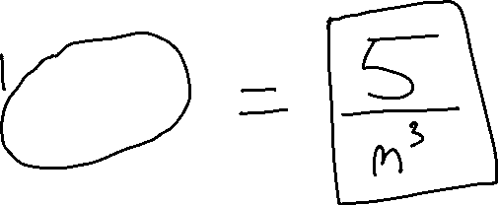
Example 1
$${5m}^{−3}$$

Slide 6
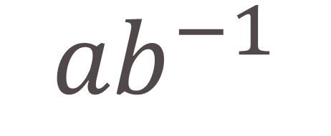
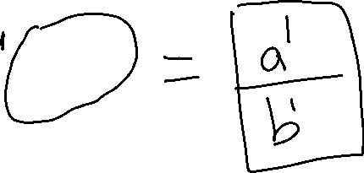
Example 2
$${ab}^{−1}$$

Slide 7

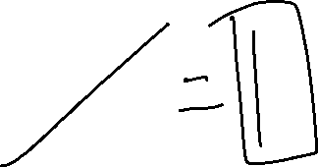
Example 3
$$p^{0}$$

Slide 8

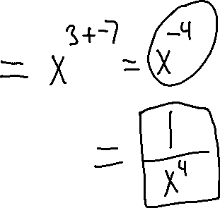
Example 4
$${x^{3} ∙x}^{−7}$$

Slide 9

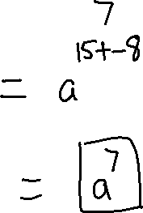
Example 5
$${a^{15} x a}^{−8}$$

Slide 10
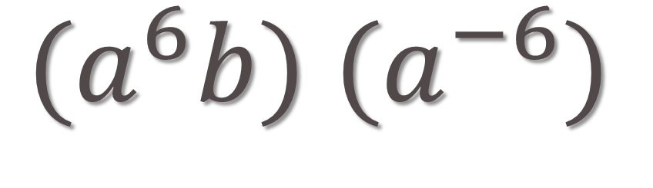
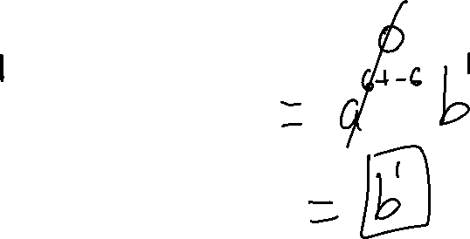
Example 6
${{(a}^{6}b) (a}^{−6})$

Slide 11
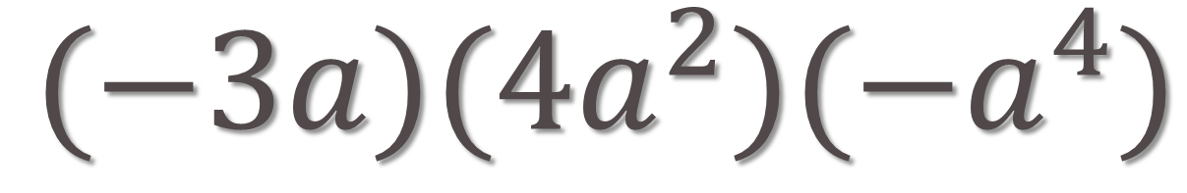
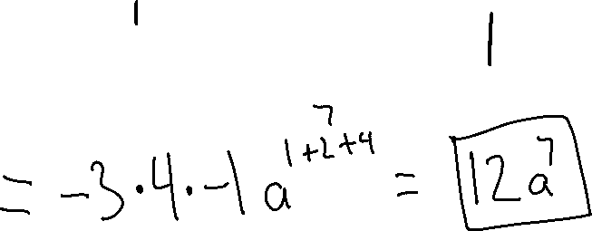
Example 7
$(−3a)(4a^{2})(−a^{4})$

Slide 12
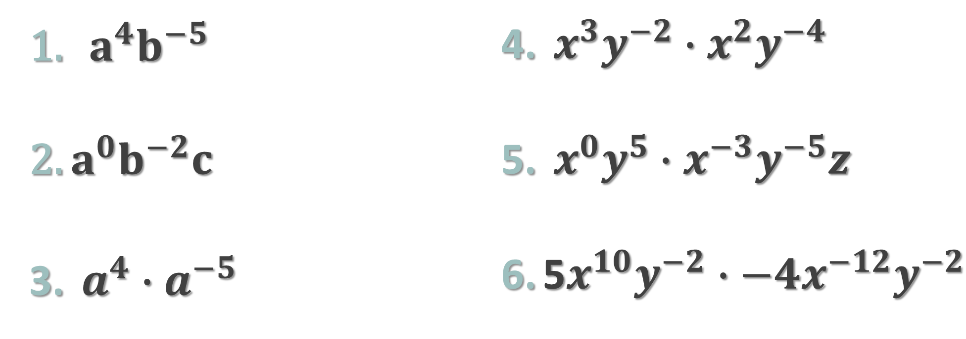
TRY THESE
$a^{4}b^{−5}$
$a^{0}b^{−2}c$
$a^{4}∙a^{−5}$
$x^{3}y^{−2}∙x^{2}y^{−4}$
$x^{0}y^{5}∙x^{−3}y^{−5}z$
5$x^{10}y^{−2}∙−4x^{−12}y^{−2}$

